Slide 1
Graph Neural Network and Fully Connected Feed Forward Neural Network based Two Phase Composition Prediction
Instructor: Prof. Shuyu Sun TA: Ronghao Cui
Thermodynamics of Subsurface Reservoirs
Final Course Project
Huseyn Yusifov
MS Student

Slide 2
Outline
Abstract
Problem Statement and Objective
Graph Neural Network GNN ( i.e. GCN)
Feed Forward Fully Connected Neural Network FFFCN
PT-Flash Calculation by Successive Submission Method SSM
Methodology
Data Collection
Results
Discussion
Conclusion

Slide 3
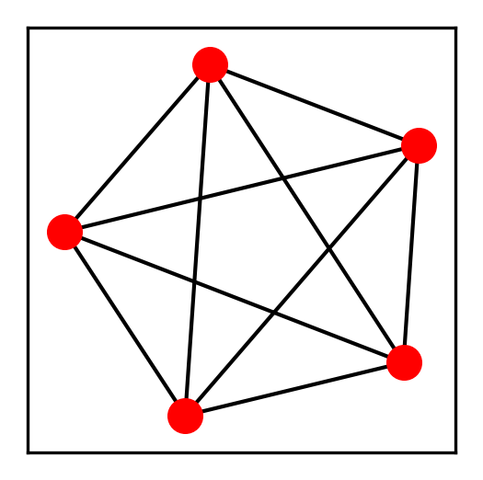
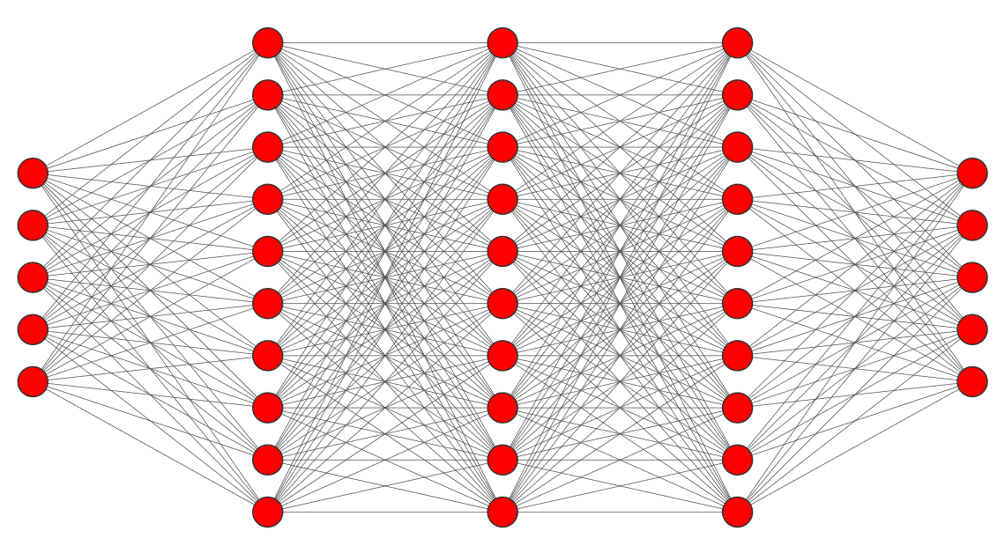
Abstract
In this presentation, I delve into the realm of predictive modeling for composition prediction, focusing on the comparison between Graph Neural Networks (GNNs) and Fully Connected Feed Forward Neural Networks (FCNNs). This study explores the efficacy of these two approaches in accurately predicting composition in a two-phase system. By leveraging the unique capabilities of GNNs to process graph-structured data and the robustness of FCNNs in capturing complex relationships, I aim to uncover insights into their respective strengths and weaknesses.
GRAPH CONVOLUTIONAL NETWORK
FULLY CONNECTED NETWORK

Slide 4
Problem Statement
Develop Python Simulator to generate Ground Truth data for Deep Learning part
Generate P, T, z input variables using random generator
Do single phase stability test to select only “unstable” compositions ( second phase coexists)
Do PT –Flash calculation and collect composition results
Develop Deep Learning Models to predict compositions from input variables
Compare the results

Slide 5
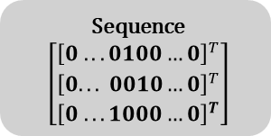

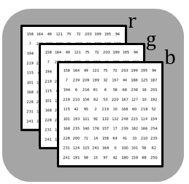
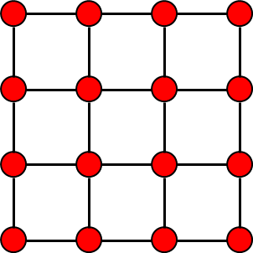
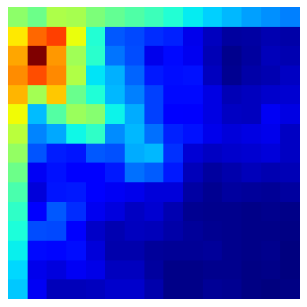
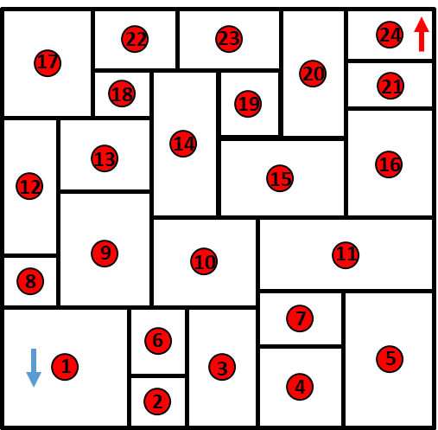
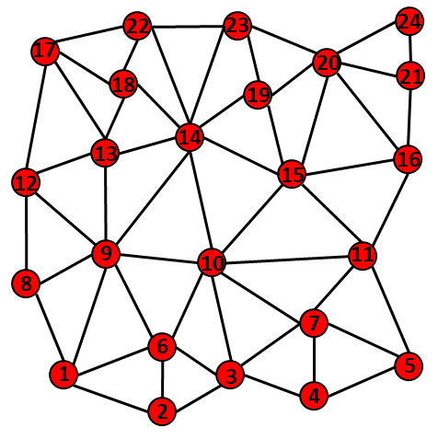




Introduction (GCNN)
What is Graph ?
Graph is data structure in other words general representation form of any data form ( voice, text, image, any data that can be represented in Euclidean and non-Euclidean System).
Euclidean
Graph Representation
Text
“Graph Convolutional Network”
Image
$$[r,g,b]$$
Physics System
$$Not Possible$$
$$(x, y, z, t, p^{1}, p^{2},…, p^{m})$$
$$\left[x, y, z, t, p^{1}, p^{2},…, p^{m}\right]$$

Slide 6

























Introduction (GCNN: Node Embedding)
ENCODER
$$ENC:R^{D}→R^{d}$$
DECODER
$$DEC:R^{d}→R^{D}$$
$$\vec{x^{5}}$$
$$R^{D}$$
$$R^{d}$$
$$R^{D}$$
$$\vec{x^{5}}$$
5
$$\vec{ψ^{5}}$$
5
$$\vec{x^{4}}$$
$$\vec{ψ^{4}}$$
$$\vec{ψ^{3}}$$
$$\vec{x^{4}}$$
4
3
$$\vec{x^{3}}$$
4
3
$$\vec{x^{3}}$$
2
2
$$\vec{x^{1}}$$
1
$$\vec{x^{2}}$$
$$\vec{ψ^{1}}$$
$$\vec{ψ^{2}}$$
1
$$\vec{x^{2}}$$
$$\vec{x^{1}}$$
$$\vec{x^{i} }$$
$${\left[\vec{ψ^{i}}\right]}^{n=0}=\vec{x^{i} }$$
$${\left[\vec{ψ^{i}}\right]}^{n=0}=\vec{x^{i} }$$
Neighborhood Embeddings at n-th layer
$${\left[\vec{ψ^{i}}\right]}^{n+1}= σ\left(W_{n}\sum_{j ∈N(i)}{\frac{{\left[\vec{ψ^{j}}\right]}^{n}}{N(i)}}\right)$$
Embedding of Target Node at n+1-th layer
Non-Linearity
Learnable Parameter at n-th layer
$$\vec{x^{i} } ∈R^{D}$$
$$\vec{ψ^{i}}∈R^{d} d<D$$

Slide 7
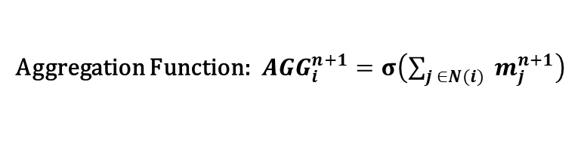
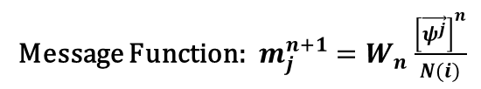
Introduction (GCNN: Message & Aggregation)
Message:
Message Function:${ m}_{j}^{n+1} =W_{n}\frac{{\left[\vec{ψ^{j}}\right]}^{n}}{N(i)}$
Meaning: In graph each node has interaction between its defined neighbor(s)…
During forward propagation, each neighbor node send its message to encode target node in pre-defined latent space
Aggregation:
Aggregation Function:${ AGG}_{i}^{n+1} =σ\left(\sum_{j ∈N(i)}{{ m}_{j}^{n+1}}\right)$
Meaning: Messages come from each neighbor node will be aggregated (combined) to form target node in latent space

Slide 8




























Introduction (GCNN: Example of 2 Layers Node Embedding)
message
aggregation
$${\left[\vec{ψ^{4}}\right]}^{0}$$
4
L1
$${\left[\vec{ψ^{1}}\right]}^{1}$$
$${\left[\vec{ψ^{2}}\right]}^{0}$$
1
2
$${\left[\vec{ψ^{1}}\right]}^{0}$$
$$\vec{x^{5}}$$
1
5
$${\left[\vec{ψ^{3}}\right]}^{0}$$
L1
$$4$$
$$3$$
3
$${\left[\vec{ψ^{2}}\right]}^{1}$$
L2
$${\left[\vec{ψ^{4}}\right]}^{2}$$
$$\vec{x^{4}}$$
$$5$$
2
4
4
$$6$$
3
$${\left[\vec{ψ^{4}}\right]}^{0}$$
$$\vec{x^{3}}$$
4
$$7$$
2
$$2$$
$${\left[\vec{ψ^{5}}\right]}^{0}$$
1
$$1$$
$$\vec{x^{2}}$$
5
$$\vec{x^{1}}$$
Latent Space 2
$${\left[\vec{ψ^{2}}\right]}^{0}$$
2
$${\left[\vec{ψ^{3}}\right]}^{0}$$
L1
$${\left[\vec{ψ^{5}}\right]}^{1}$$
3
5
$${\left[\vec{ψ^{4}}\right]}^{0}$$
Latent Space 1
4
$${\left[\vec{ψ^{i}}\right]}^{n=0}=\vec{x^{i} }$$
$$\vec{x^{i} } ∈R^{D}$$
$$\vec{ψ^{i}}∈R^{d} d<D$$

Slide 9




















GCNN- Application
$$\vec{x^{i} } is d dimensional feature vector of i^{th} node, \vec{x^{i} } ∈R^{D}$$
Composition Model
Graph in Visualization
Graph in Computer Science
Adjacency Matrix
Feature Matrix
$$\vec{x^{5}}$$
1
2
3
4
5
5
5
$$\vec{x^{4}}$$
1
0
1
0
1
0
$$\vec{x^{1}}$$
Undirected
4
3
4
3
2
1
0
1
1
1
$$\vec{x^{2}}$$
2
$$\vec{x^{3}}$$
3
0
1
0
0
1
$$\vec{x^{3}}$$
2
1
1
$$\vec{x^{2}}$$
4
1
1
0
0
1
$$\vec{x^{4}}$$
$$\vec{x^{1}}$$
5
0
1
1
1
0
$$\vec{x^{5}}$$
$$\vec{x^{5}}$$
1
2
3
4
5
5
5
$$\vec{x^{4}}$$
1
0
1
0
0
0
$$\vec{x^{1}}$$
Directed
4
3
4
3
2
0
0
1
0
0
$$\vec{x^{2}}$$
2
$$\vec{x^{3}}$$
3
0
0
0
0
0
$$\vec{x^{3}}$$
2
1
$$\vec{x^{2}}$$
4
1
$$\vec{x^{1}}$$
1
1
0
0
1
$$\vec{x^{4}}$$
5
0
1
1
0
0
$$\vec{x^{5}}$$

Slide 10
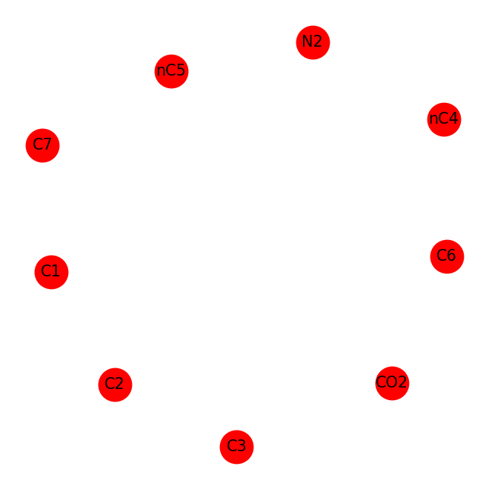
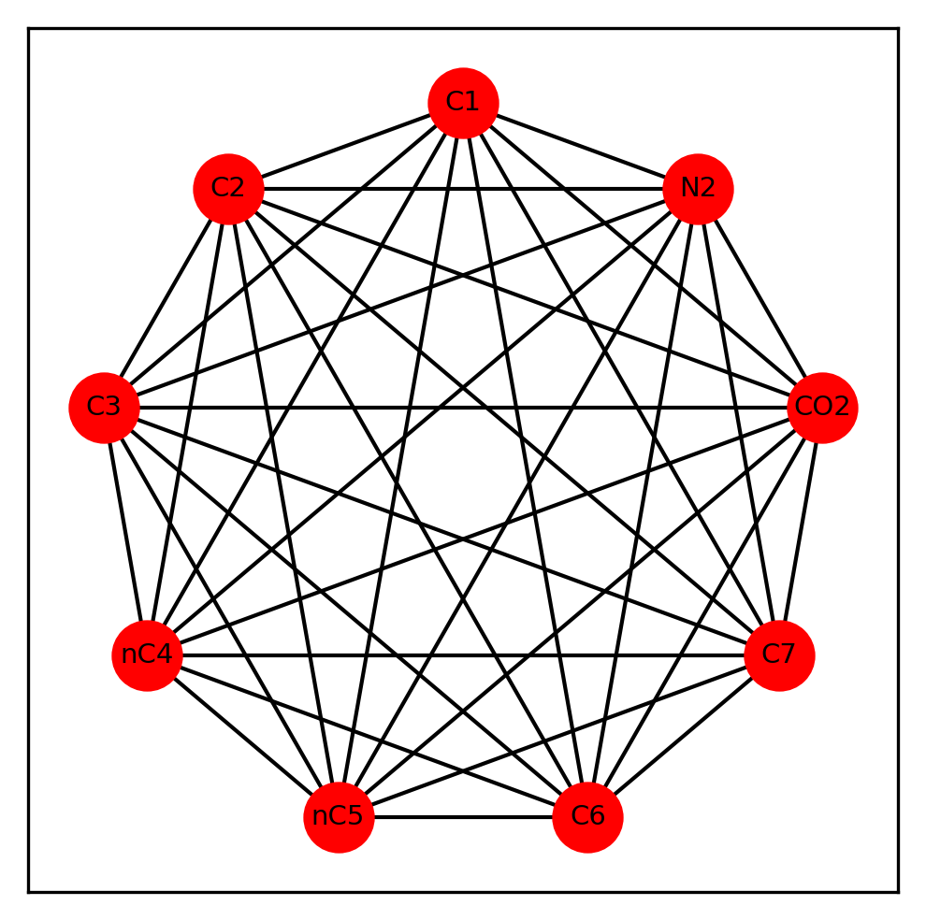
GCNN- Application on Problem
Composition Model
Undirected – Graph

Slide 11
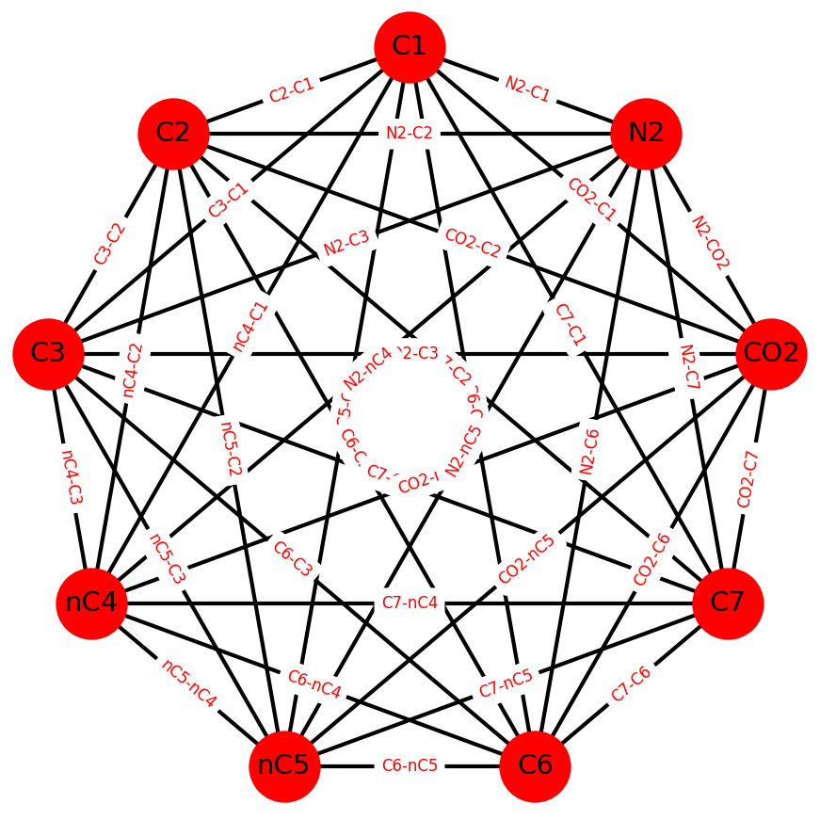


GCNN - Why ?
Real world objects are often defined in terms of their connections to other things. A set of objects, and the connections between them, are naturally expressed as a graph.
In this problem, we also know that each component in the composition interacts with others. So, I decided represent my composition model as a graph. Nodes represent components, edges represent interaction between components.
$X^{C1}$=[P T Pc Tc w z]
Feature Vector of Components (Nodes)
Binary Interaction Coefficient
$X^{CO2}$=[P T Pc Tc w z]

Slide 12
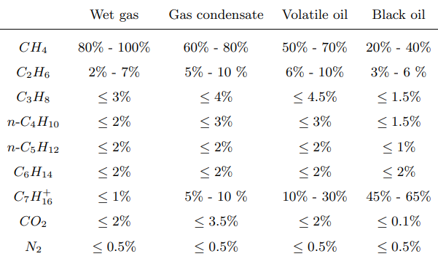
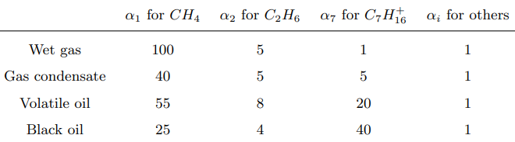

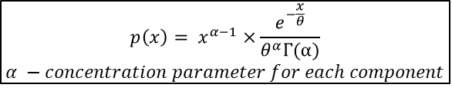


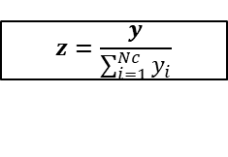
Data Generation
$$p\left(x\right)= x^{α−1}×\frac{e^{−\frac{x}{θ}}}{θ^{α}Γ\text{(}α)}$$
$$α −concentration parameter for each component$$
$$y=\left[y_{1}……y_{Nc}\right]$$
$$z=\frac{y}{\sum_{i=1}^{Nc}{y_{i}}}$$
$$5 MPa<P<25 MPa$$
$$200K<T<600 K$$
$$Totally 125000 samples were generated in different combinations of T, P and z$$

Slide 13











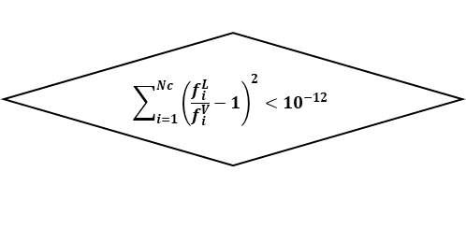


Successive Substitution Method for Phase Split
Newton-Raphson
Iteration
Wilson’s Correlation
$$K_{i}^{(0)}=\frac{P_{c,i}}{P}e^{(5.373(1+ω_{i})(1 − \frac{T_{c,i}}{T}))}$$
Rachford-Rice equation
$$f_{RR}\left(θ_{V}, K\right)=\sum_{i=1}^{N_{c}}{\frac{(K_{i}^{\left(k\right)}−1)z_{i}}{1+(K_{i}^{\left(k\right)}−1)θ_{V}}}=0$$
$$θ_{V}^{(k)}$$
Mass Balance Equation
$$x_{i}^{(k)}$$
$$y_{i}^{(k)}$$
Peng-Robinson EOS
(cubic form)
$$Z_{i}^{L,(k)}$$
$$Z_{i}^{V,(k)}$$
$$False$$
$$\sum_{i=1}^{Nc}{{\left(\frac{f_{i}^{L}}{f_{i}^{V}}−1\right)}^{2}<{10}^{−12}}$$
$$f_{i}^{L,(k)}$$
$$f_{i}^{V,(k)}$$
$K_{i}^{(k+1)}=$ $K_{i}^{(k)}{\left(\frac{f_{i}^{L}}{f_{i}^{V}}\right)}^{k}$
Peng-Robinson Fugacity Formula
$$True$$
$x_{ }^{(k)}$, $y_{ }^{(k)}$, $θ_{V}^{(k)}$
SSM

Slide 14


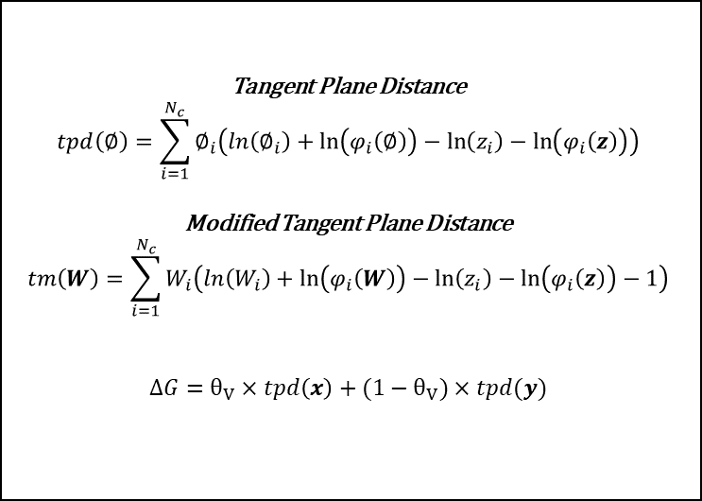

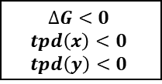












Single Phase Stability Analysis
$$({\text{P} \text{T} \text{z} )}^{n}$$
Second Phase Coexists. Store $n^{th}$sample .
~22000 Samples Stored
With Their Results
$$SSM$$
Tangent Plane Distance
$$tpd\left(∅\right)=\sum_{i=1}^{N_{c}}{∅_{i}\left(ln\left(∅_{i}\right)+\ln\left(φ_{i}\left(∅\right)\right)−\ln\left(z_{i}\right)−\ln\left(φ_{i}\left(z\right)\right)\right)}$$
Modified Tangent Plane Distance
$$tm\left(W\right)=\sum_{i=1}^{N_{c}}{W_{i}\left(ln\left(W_{i}\right)+\ln\left(φ_{i}\left(W\right)\right)−\ln\left(z_{i}\right)−\ln\left(φ_{i}\left(z\right)\right)−1\right)}$$
$$∆G=θ_{V}×tpd\left(x\right)+(1−θ_{V})×tpd(y)$$
$0<θ_{V}$ <1
$$×9$$
$$True$$
$$or$$
$$∆G<0$$
$$tpd\left(x\right)<0$$
$$tpd\left(y\right)<0$$
$$True$$
$$True$$
$$False$$
$$tm\left(W^{L},z\right)<0$$
$$tm\left(W^{V},z\right)<0$$
$$or$$
$$False$$
$$W^{V}=Kz$$
$$W^{L}=\frac{z}{K}$$
SSM accelerated by the Dominant Eigenvalue Method
$${ln(W}^{α,(k+1)}) =ln\left(z\right)+ln\left(φ_{ }\left(z\right)\right)−{ln⁡(φ_{ }(W}^{α,\left(k\right)}))$$

Slide 15
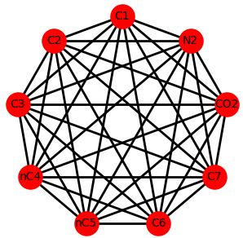
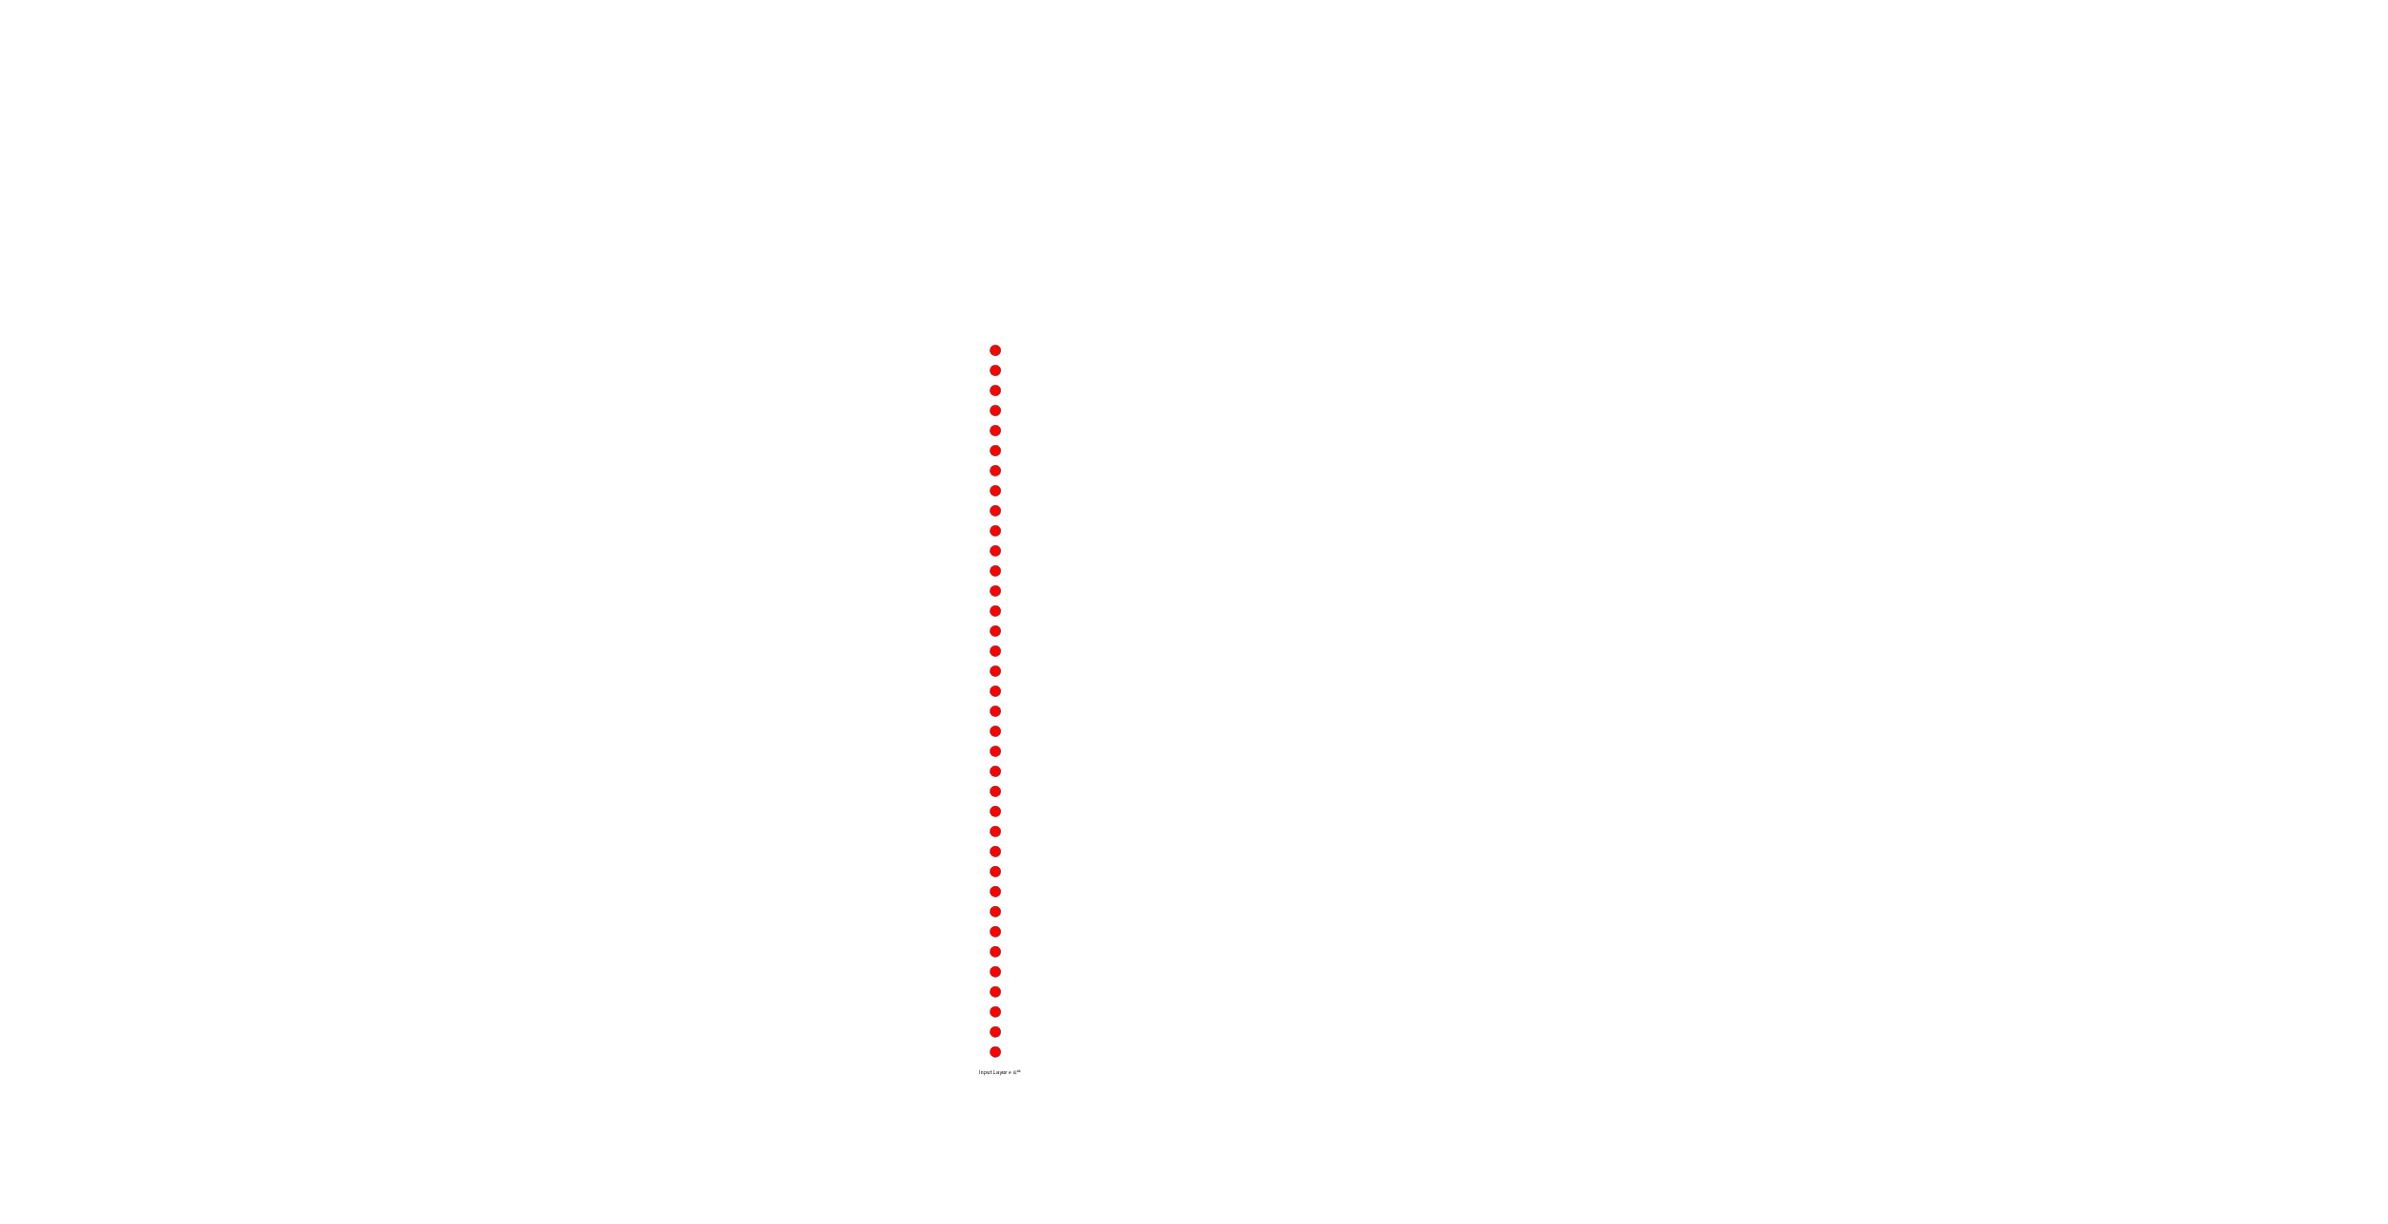
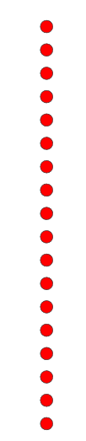






DL Model Architecture : GCNNs and FCNNs (General)
P T Pc Tc w z
P T Pc Tc w z
x y
x y
Feature Matrix
Result Matrix
9x6
Edge Connections
2xN
9x2
Edge Weight
1xN
Feature Vector
Result Vector
P
T
+
$$P_{c,i}$$
$$T_{c,i}$$
$$w_{c,i}$$
$$z_{c,i}$$
x9
$$x_{i}$$
$$y_{i}$$
x9
1x38
1x18

Slide 16














DL Model Architecture : GCN (Detailed)
$$σ_{act}$$
$$σ_{act}=tanh(x)$$
$$h_{1}^{1}$$
$$σ_{act}$$
$$h_{4}^{2}$$
$$h_{0}^{0}$$
$$σ_{act}$$
X
$$σ_{act}$$
$$h_{6}^{3}$$
$$h_{2}^{1}$$
$$σ_{act}$$
X
$$h_{5}^{2}$$
$$σ_{act}$$
X
$$h_{3}^{1}$$
6 Features
IN = 6 OUT = 24
IN = 24 OUT = 12
IN = 12 OUT = 2
2 Features

Slide 17
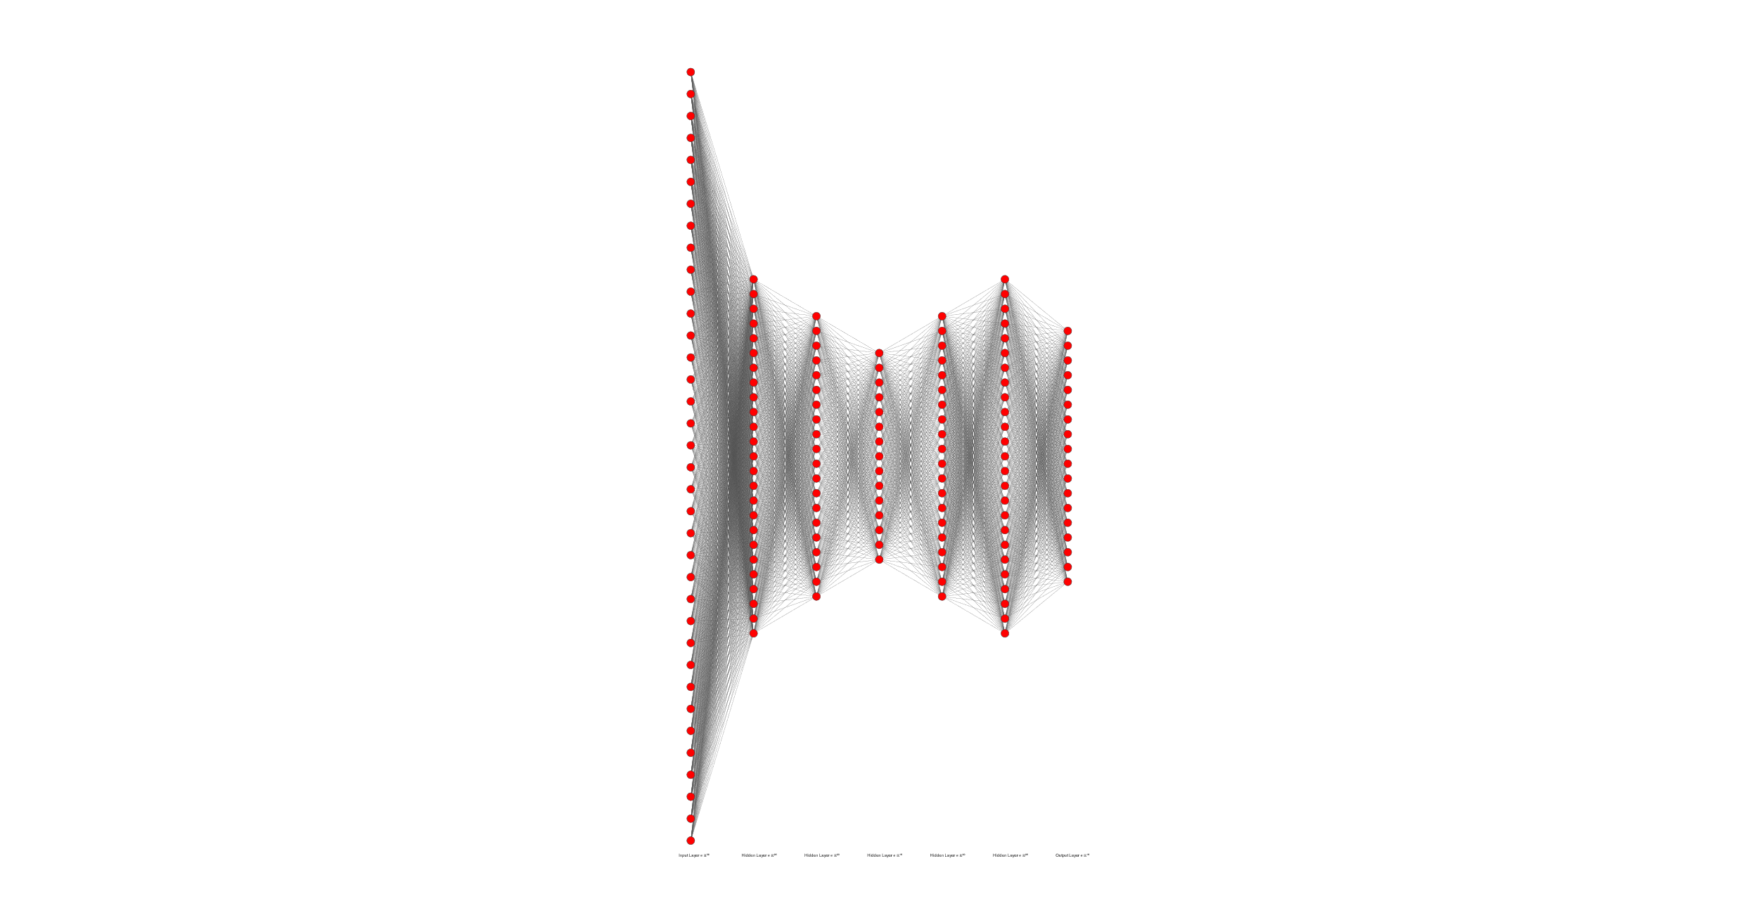






DL Model Architecture : FCNN (Detailed)
$$σ_{act}=tanh(x)$$
IN = 25 OUT = 20
IN = 25 OUT = 18
IN = 15 OUT = 20
36 INPUTS
$$σ_{act}$$
$$σ_{act}$$
$$σ_{act}$$
$$σ_{act}$$
$$σ_{act}$$
$$σ_{act}$$
18 OUTPUTS
IN = 20 OUT = 15
IN = 20 OUT = 25
IN = 36 OUT = 25

Slide 18
Methodology: Work-Flow (PyTorch Library)
Data Generator
P T z
class GCN(nn.Module):
UPDATE PARAMETERS
gcnNET->forward
Stability Analysis
predict
loss
optimizer
LBFGS
Store Samples
~22000
Send Data to CUDA
NVIDIA RTX 3070Ti
Send Data to CUDA
NVIDIA RTX 3070Ti
class FCN(nn.Module):
fcnNET->forward
predict
SSM
loss
optimizer
Adam
Store X Y
UPDATE PARAMETERS

Slide 19
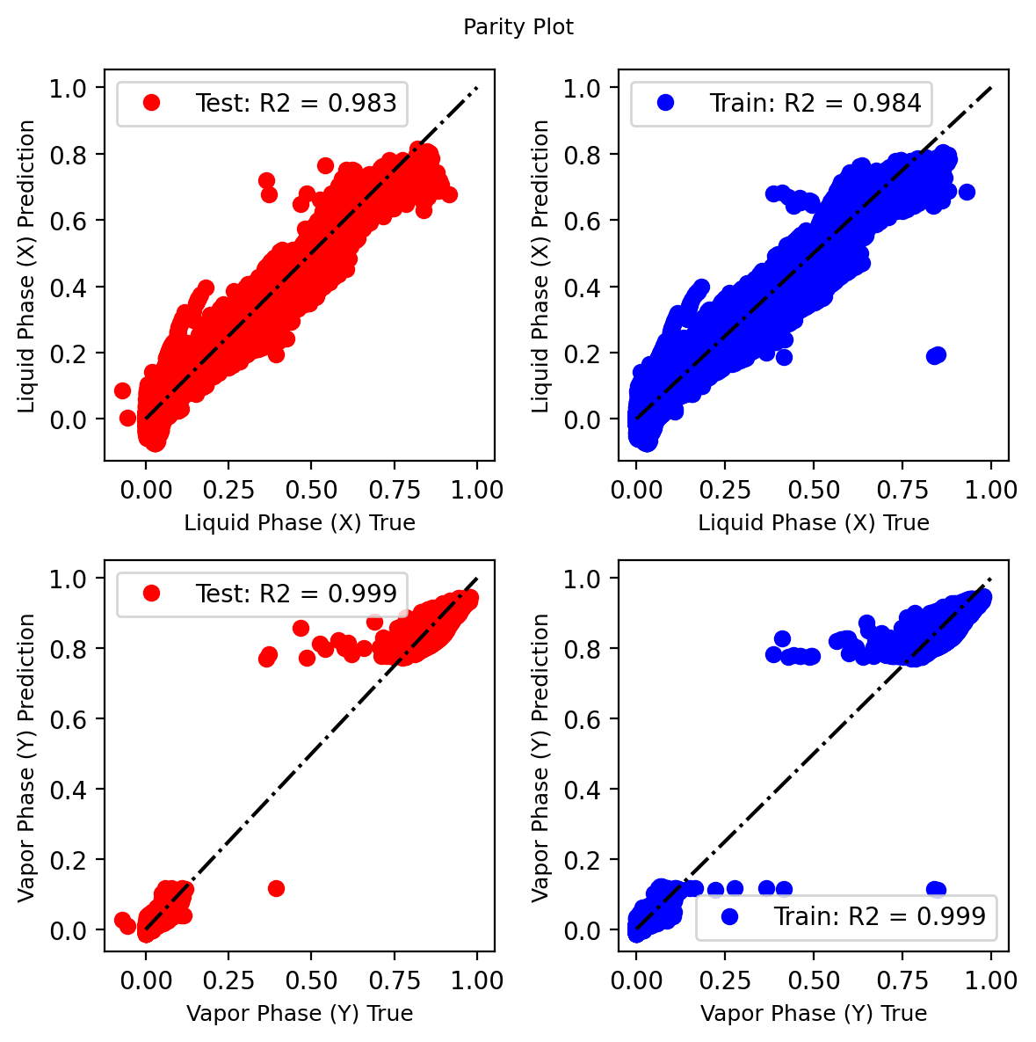
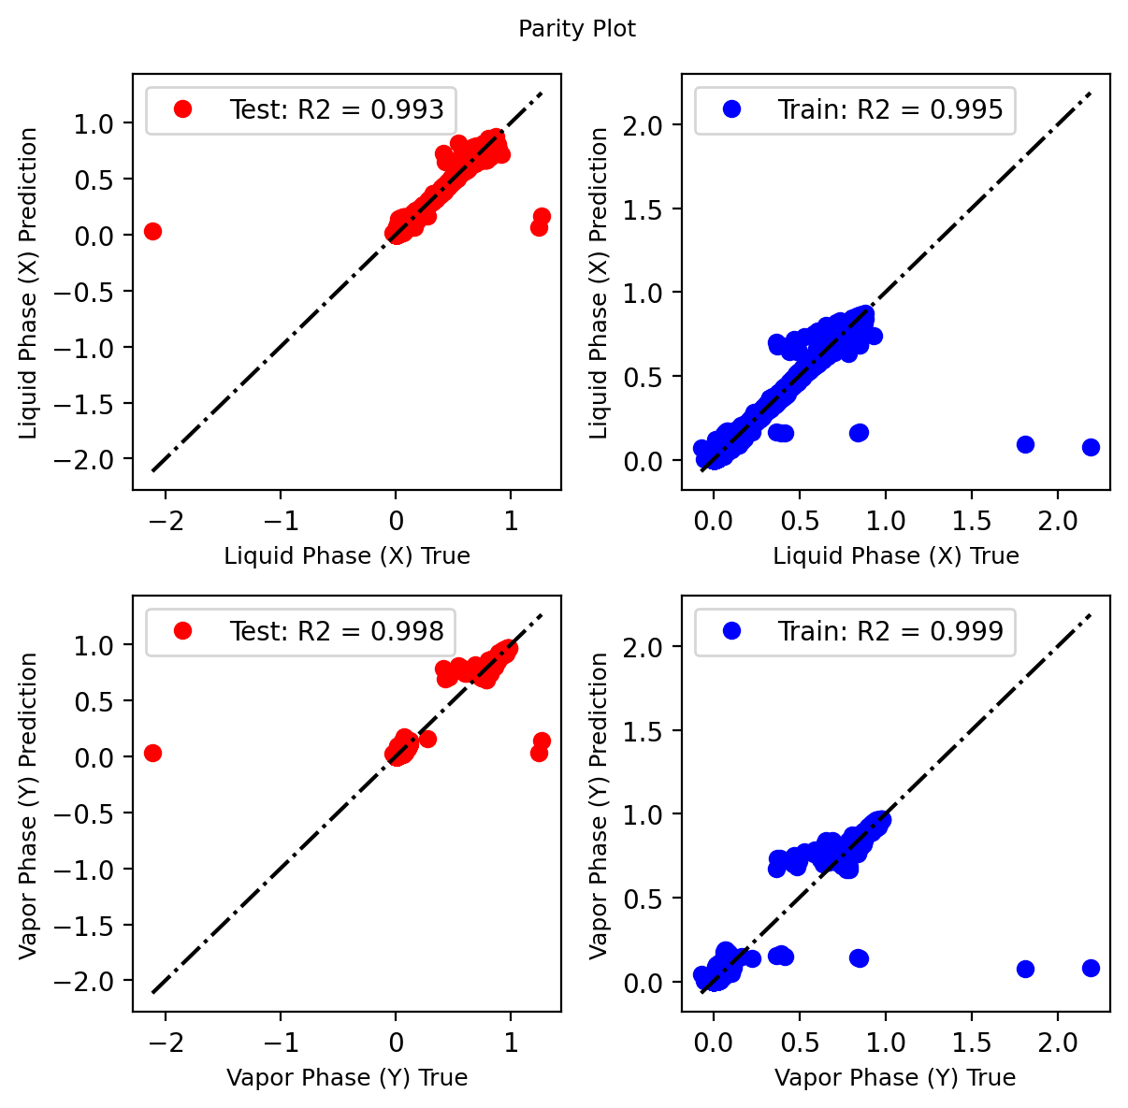
Results
GCN
FCN

Slide 20
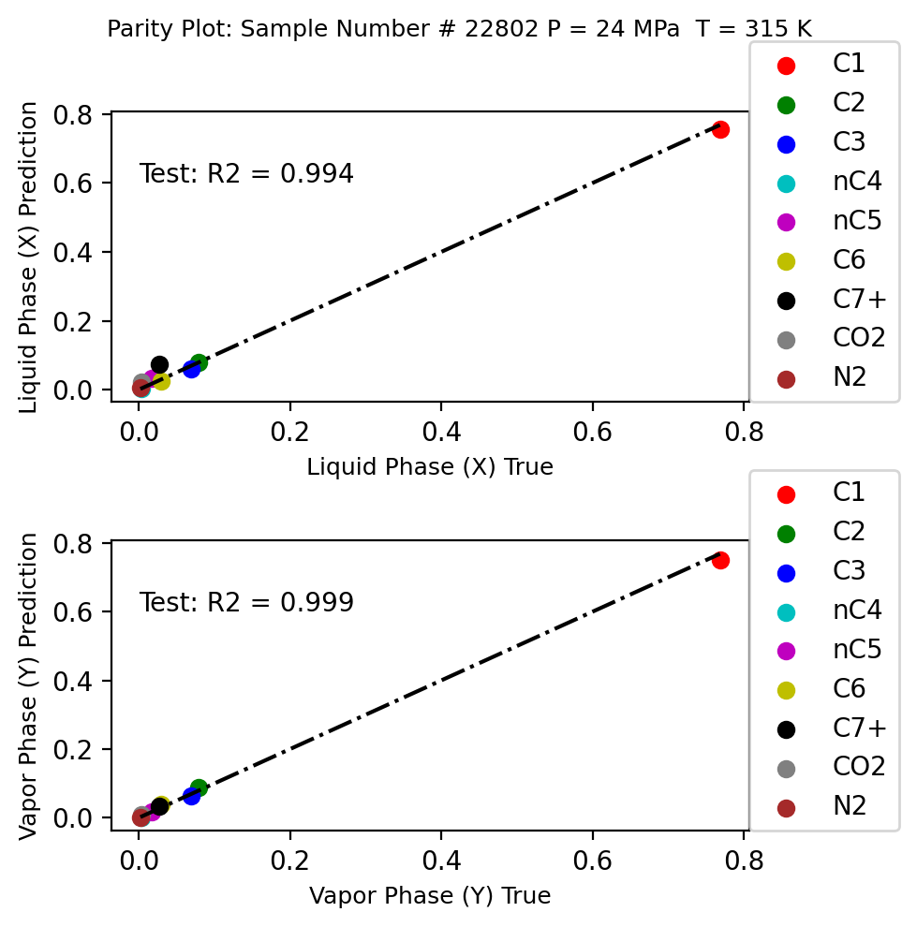
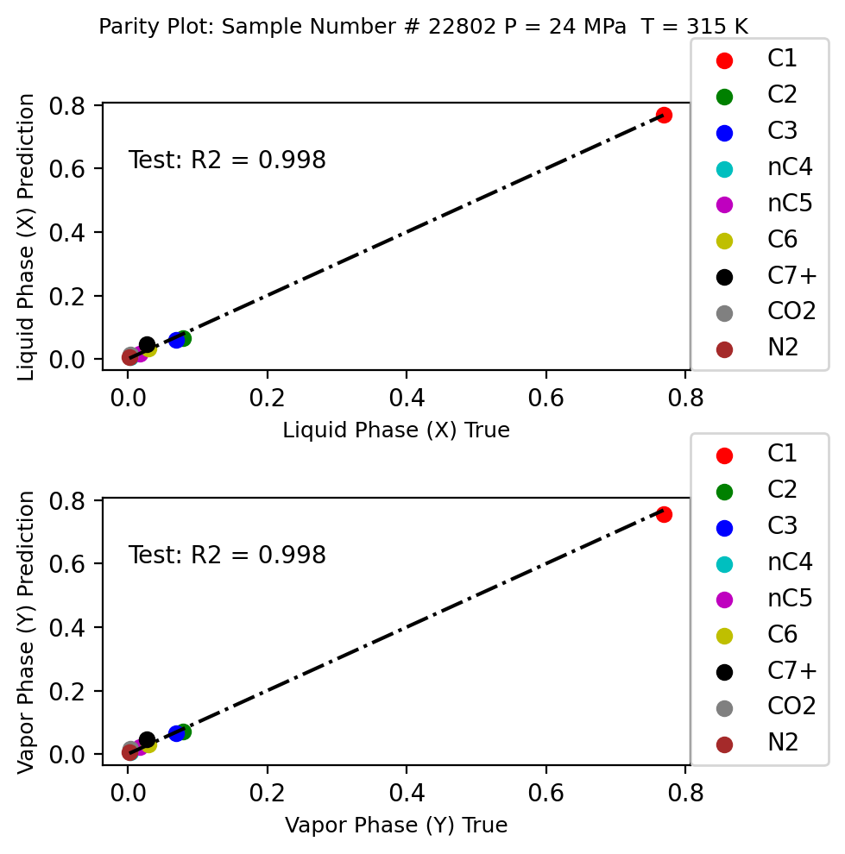
Results
GCN
FCN

Slide 21
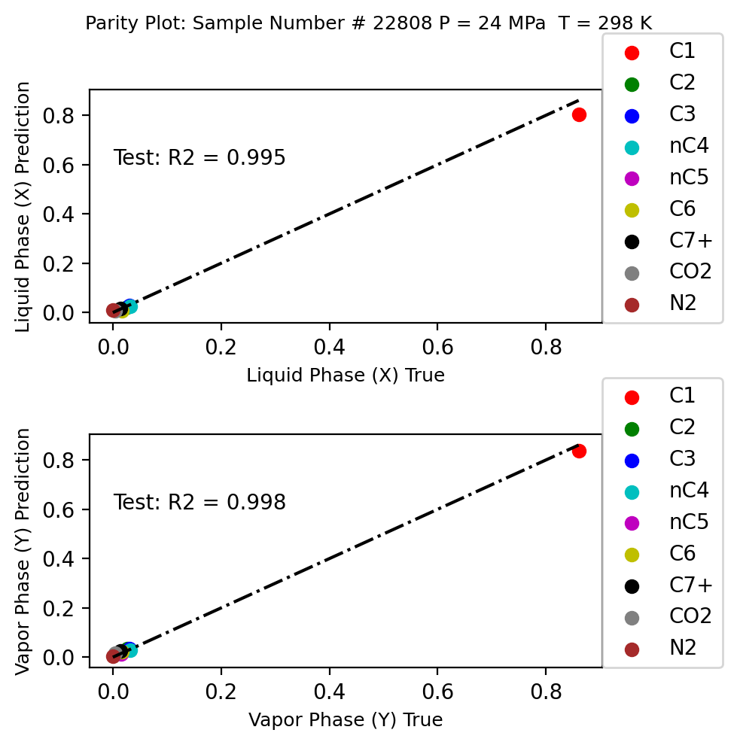
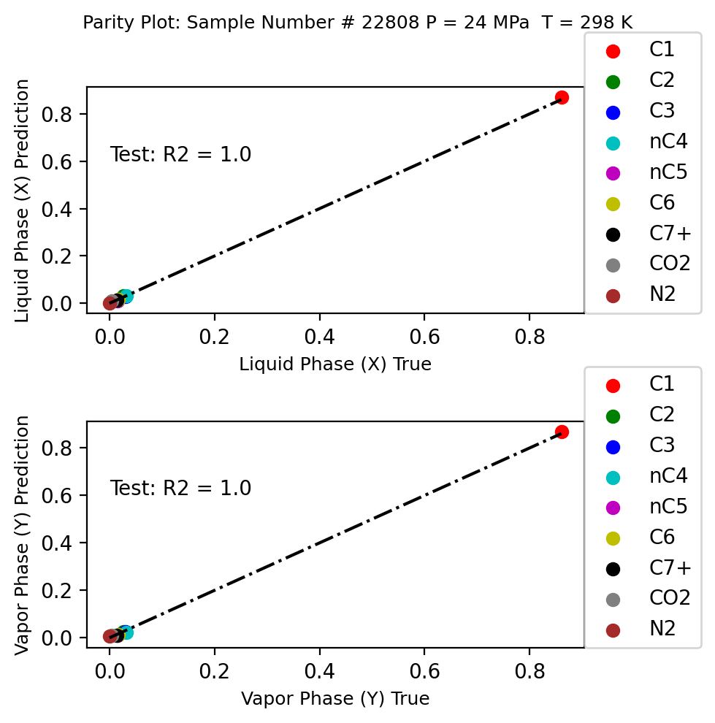
Results
GCN
FCN

Slide 22
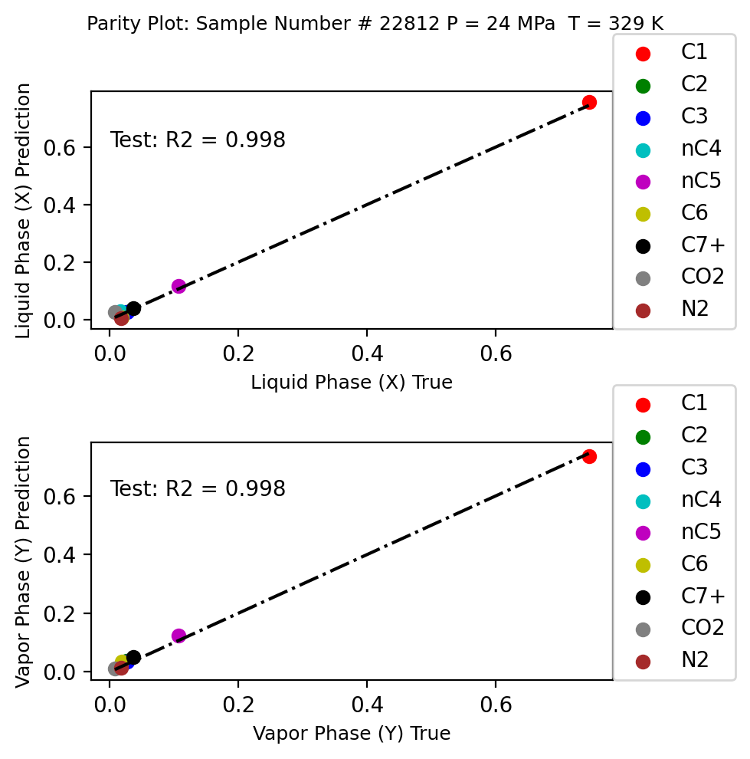
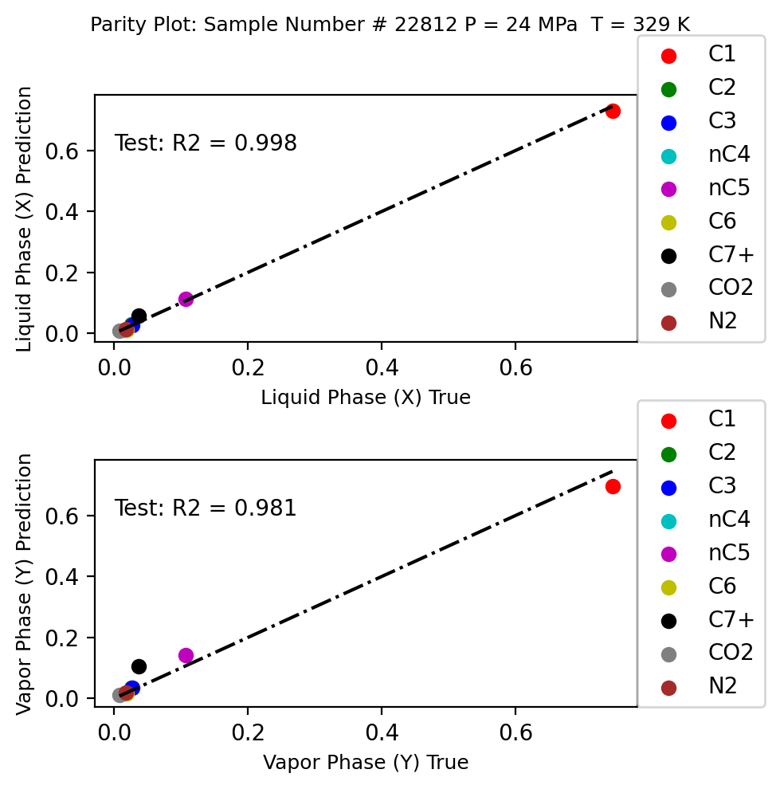
Results
GCN
FCN

Slide 23
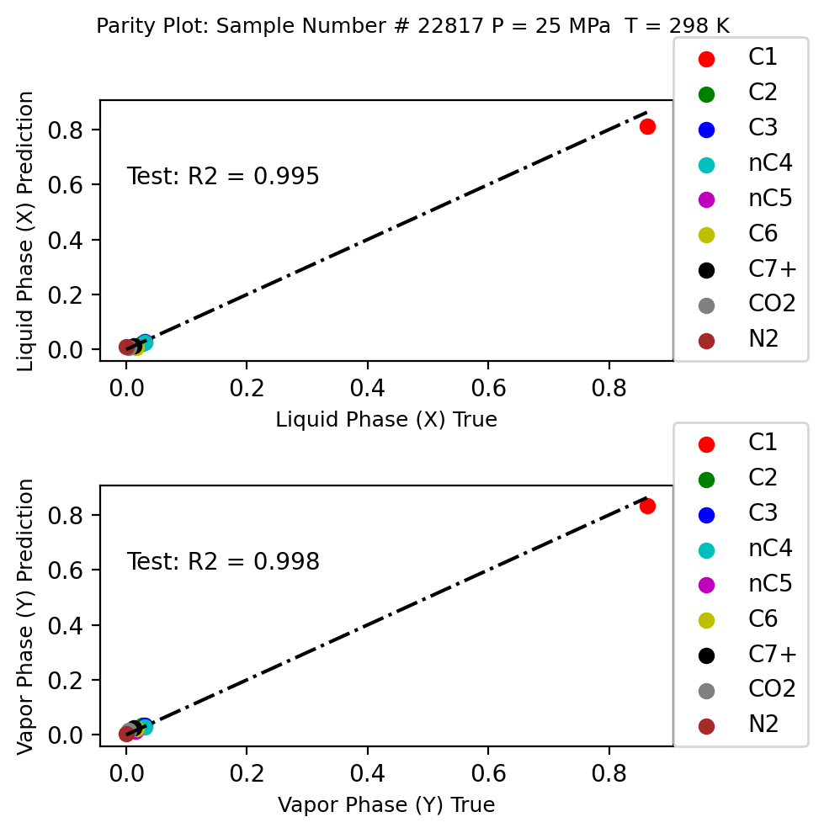
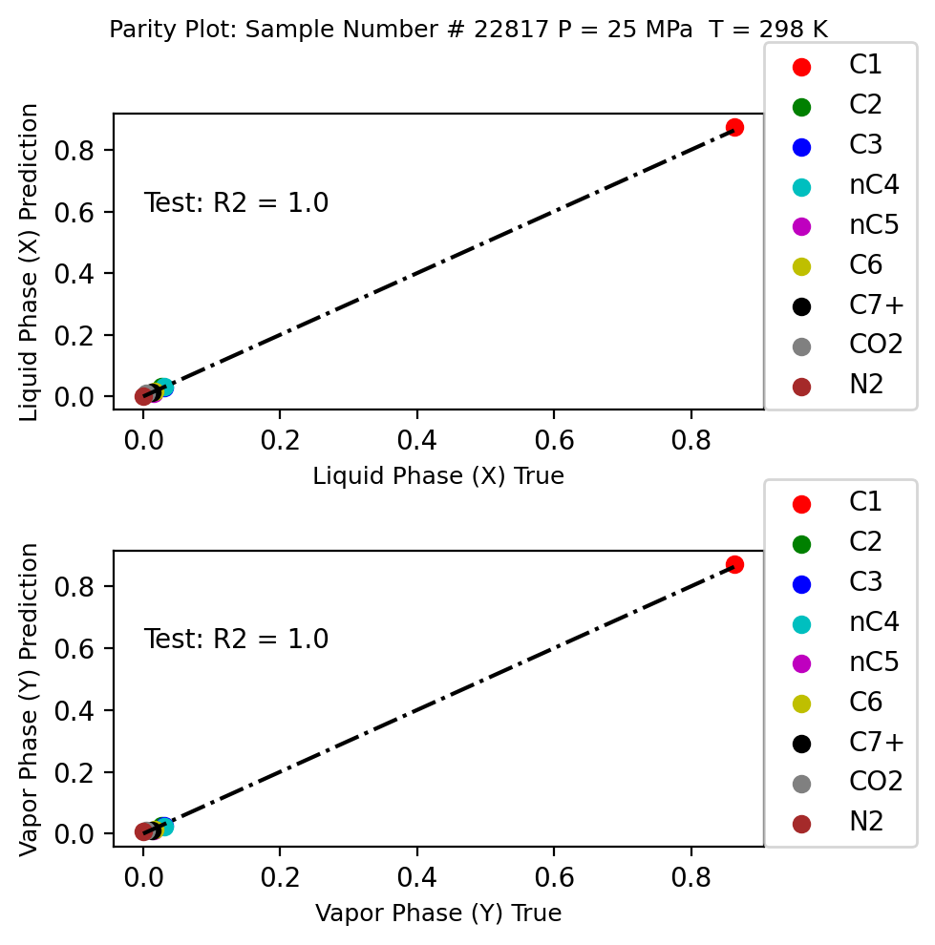
Results
GCN
FCN

Slide 24
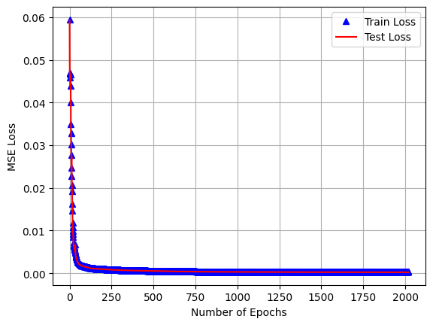
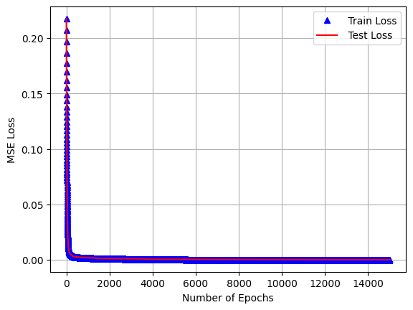
Discussion: Part I
GCN
FCN

Slide 25
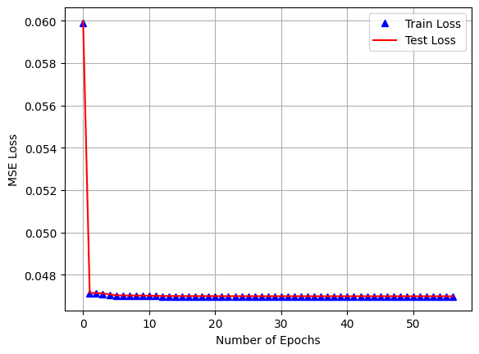
Discussion: Part II
GCN with BIP
GCN without BIP

Slide 26
Reference
Stanford University, CS224W: Machine Learning with Graphs
https://web.stanford.edu/class/cs224w/
Jingang Qu, Thibault Faney, Jean-Charles de Hemptinne, Soleiman Yousef, Patrick Gallinari. PTFlash : A vectorized and parallel deep learning framework for two-phase flash calculation. Fuel, 2023,
331, Part 1, pp.125603. ff10.1016/j.fuel.2022.125603ff. ffhal- 03659647v3f

